Slide 1
Health Studies Unit 2
Year 11
2019
Mr Orr

Slide 2
Community Development
Part 1:
Definition, purpose and principles.

Slide 3
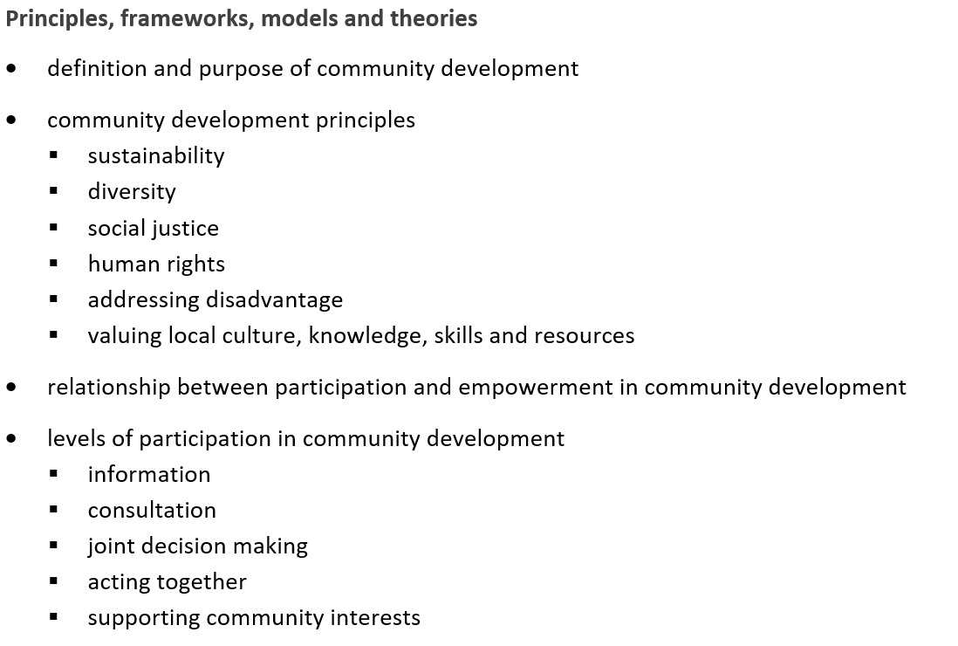
Syllabus link

Slide 4
What do you know?
What makes up a community?
Are you a part of a community?
What would you associate with the word “development”?
Speed and growth?
Change.
What do you believe community development is?

Slide 5
Community development is a structured intervention. The idea is that the intervention will:
Give the community greater control over the conditions that affect their lives.
Address issues of powerlessness and disadvantage
Empower people to be a part of social change.
DEFINITION:
“The process of involving communities from the ground up in their own decision making about factors relating to health” (Allen, 1997, as cited in Egger, Spark 7 Donovan, 2005)

Slide 6
The development of a community is more than just infrastructure.
Community developers must be able to identify the “values, needs and aspirations of residents, community members, businesses and other appropriate stakeholders for the benefit of all involved”.

Slide 7
Who is community development for?
Disempowered, disengaged communities with ongoing inequalities specific to health experiences based on socioeconomic class, gender, race and ethnicity (Jackson et al, 1989, as cited in Egger, Spark & Donovan, 2005).
These individuals are considered the ‘hardest to reach’, with the poorest overall health statuses.

Slide 8
Community development
According to Egger, Spark & Donovan, 2005, Community development should incorporate the following elements:
Knowledge of the health and health related problems of the focus community.
Comprehensive knowledge of the focus community (population, class, age structure, available resources, knowledge of the normal processes of the community)
Identification of community leaders
Opinion surveys conducted in the community

Slide 9
Principles of Community Development
There are six key principles of community development:
1) Sustainability
2) Diversity
3) Human rights
4) Social justice
5) Addressing disadvantage
6) Valuing local knowledge
By addressing these six key areas, community developers aim to improve the skills of communities to address issues that they may be facing.

Slide 10

SUSTAINABILITY
The ability to be maintained at a certain rate or level

Slide 11
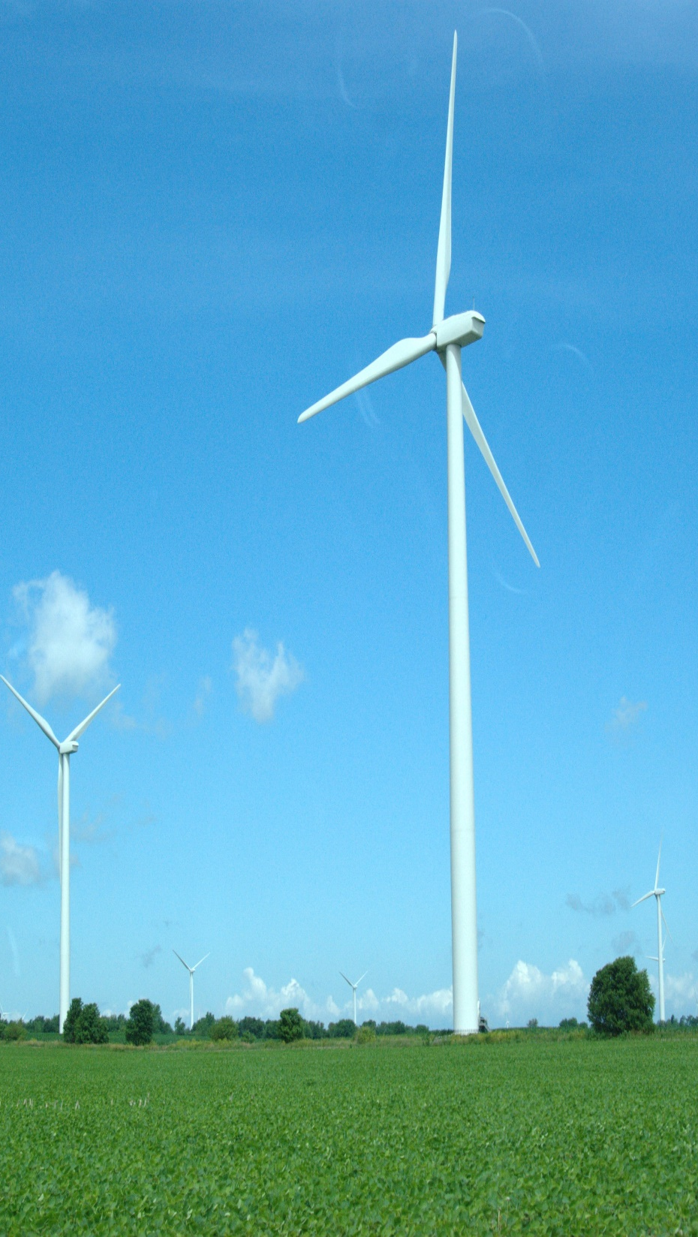
Sustainability
In order for a community to be sustainable they must be able to meet needs in the present, whilst having a long-term plan for the future.
To be able to achieve this, it is important to increase community participation in projects. This will empower individuals and the community.
Essentially, the community must have the resources for today, whilst at the same time having plans in place to keep these resources for the future.
This Photo by Unknown Author is licensed under CC BY-SA

Slide 12

DIVERSITY
Ted talk (time permitting) (13 mins)
Research on diversity https://www.youtube.com/watch?v=kJx7_JpxlxA
The state of being diverse; that is being different.

Slide 13

Diversity
This is the “quality of being different”.
Can consist of differences in age, gender, culture, ethnicity and education.
Although community development may implement change, it is important that diversity is respected. All changes need to be equitable to all.
This Photo by Unknown Author is licensed under CC BY

Slide 14

HUMAN RIGHTS
The basic rights and freedoms that all humans should be entitled to

Slide 15

Human Rights
“Human rights recognise the inherent value of each person, regardless of background, where we live, what we look like, what we think or what we believe.
They are based on principles of dignity, equality and mutual respect, which are shared across cultures, religions and philosophies. They are about being treated fairly, treating others fairly and having the ability to make genuine choices in our daily lives.”
(Australian Human Rights Commission)
What do you believe comes under the banner of human rights?
https://www.ohchr.org/en/udhr/documents/udhr_translations/eng.pdf
Examples pg 126.
This Photo by Unknown Author is licensed under CC BY-NC-ND

Slide 16

SOCIAL JUSTICE
Social justice is the equal distribution of resources and opportunities, in which outside factors that categorize people are irrelevant.

Slide 17

Social Justice
Social justice is based on human rights and may hold some or all of the following beliefs:
1) All historical inequalities that affect current injustices should be corrected until they no longer exist. (stolen generation, black lives matter- US police shootings, Injustices of refugees fleeing war)
2) Wealth, power and status should be redistributed for the good of the individual, community and society.
3) The government has the responsibility of ensuring that all of its citizens have a basic quality of life.
This Photo by Unknown Author is licensed under CC BY

Slide 18
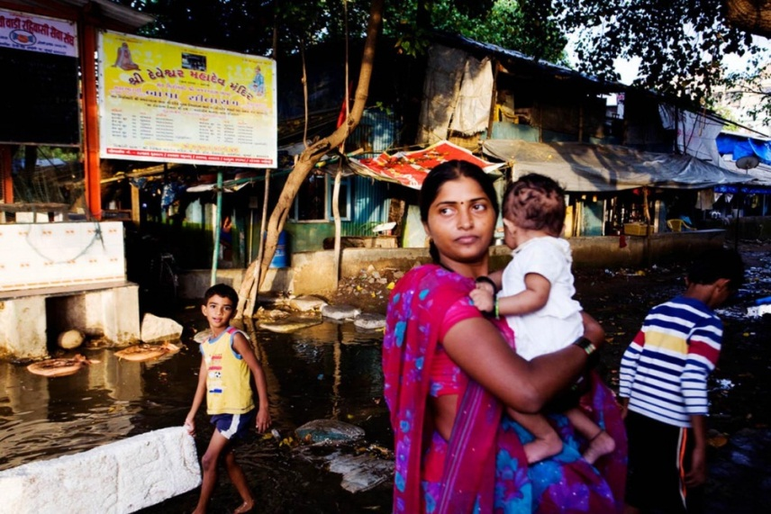
ADDRESSING DISADVANTAGE
Communities that are disadvantaged require attention and effort to redeem their community health

Slide 19

Addressing Disadvantage
Is the responsibility of governments, policy makers, and the United Nations.
Funds should be directed towards projects or programs to reduce/eradicate poverty and disadvantage.
Example “Indigenous Community Volunteers”
http://www.icv.com.au/

Slide 20
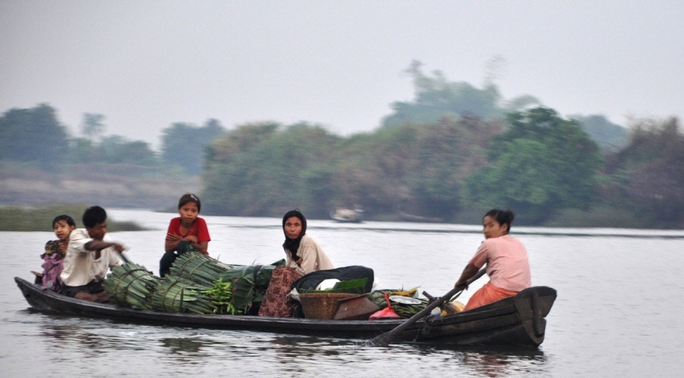
VALUING LOCAL KNOWLEDGE
We need to recoqnise that local knowledge is valuable and necessary for the success and sustainability of community development programs

Slide 21
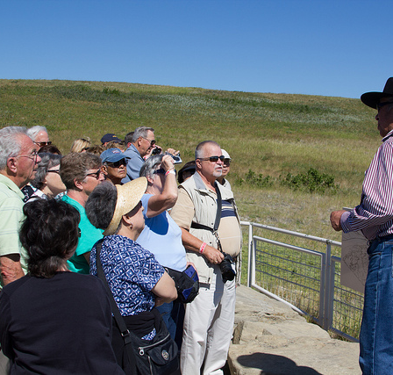
Valuing Local Knowledge
Communities will already have a sound knowledge of their environment, and it is important for community developers to recognise this.
Health promoters can facilitate locals to use the skills that will both develop and maintain their sustainability.
https://www.anbg.gov.au/gardens/education/programs/pdfs/aboriginal_plant_use_and_technology.pdf
This Photo by Unknown Author is licensed under CC BY

Slide 22
Revision Questions:
Outline 2 communities that would benefit from community development in Australia and why.
Research “Indigenous Community Volunteers” and find examples of how it addresses the six principles of community development.

Slide 23
Homework:
On a lined piece of paper, write a response to the following question:
Identify and define FOUR of the six principles of Community Development. Explain why each is important to the implementation of an effective community development initiative.
(12 marks)

Slide 24
Syllabus link

Slide 25
Source
Egger, G., Spark, R., & Donovan, R. (2005). Health Promotion Strategies and Methods (Second Edition). Australia: McGraw-Hill Medical.
Lockhart, E. (2010). Health Studies Stage 2A-b. Madeley: Print Publishing.

Slide 26
Revision from yesterday:
Explain, using a definition and your own words, what Community Development is.
(short paragraph)
Explain (with reference to an example) what type of communities might require intervention with a community development program.
(short paragraph)

Slide 27
Community Development
Part 2
Levels of participation
Relationship between Participation and Empowerment
Jakarta Declaration

Slide 28
Question:
What would make YOU want to get involved in the development of YOUR community?
-having time
-If you are passionate
-you see a need for improvement
-you are directly involved in that aspect of your community

Slide 29
Levels of Participation
Outline how much input the COMMUNITY has in the DECISION MAKING and ACTION in the INTERVENTION.
Level 1: Information (lowest level)
Level 2: Consultation
Level 3: Deciding Together
Level 4: Acting Together
Level 5: Supporting Community Interest. (highest level)
https://www.youtube.com/watch?v=2Rj6xyVwR3g 1:21

Slide 30
What does each level look like?
Example: TRAFFIC CONGESTION!!
Urban Development is aiming to reduce the number of cars on the road and increase/encourage bicycle use and pedestrian/walkway use.
Let’s see how the Levels of Participation could assist in Community Development in this area:

Slide 31
LEVEL 1: Information
People of the community are not really involved in the decision making and planning, rather they are INFORMED by the Organizers of the intervention of what is going to happen.
Eg. Government Departments make all the decisions to try to improve the issue. They carry out the intervention. The government produces billboards and tv ads to inform the community of what will be taking place, like road widening or new traffic lights.

Slide 32
LEVEL 2: Consultation
The community is more involved!
The community is asked for their feedback and opinions on the planned interventions.
Usually they are offered several options and asked for their feedback/opinions.
the ultimate decision (and action) is made by the organisers of the intervention.
The feedback MAY or MAY NOT actually be considered.
Eg. Government produces TV ads and billboards to offer a variety of solutions/options on how to reduce traffic congestion. Open Council Forum meetings are available for attendance by community members. Feedback is optional, and often in the form of an online survey. Government makes the ultimate decision and work is carried out by companies contracted by the government.

Slide 33
LEVEL 3: Deciding Together
Community members involved in decision making.
Organisers of the Intervention meet with community members (usually in round table discussion or vote format)
Organisers of the Intervention still put the plan into action.
Eg. Government departments work with members of the community to come up with a plan to reduce traffic congestion. A vote or referendum is held.

Slide 34
LEVEL 4: Acting Together
Increased participation from community members.
Organisers of the intervention work with members of the community to decide what to do and then put the plan into action together. (utilizing the expertise of the community members)
Eg.
Same as “Deciding Together” but when it comes to implementation, volunteer groups from the community, working groups, local tradesmen being employed etc.

Slide 35
LEVEL 5: Supporting Community Interest
Community conduct their own project intervention with the support of external providers.
This is the HIGHEST participation level.
(and HIGHEST empowerment!!)
Community members have all the decision making and action power.
Usually involves grants, advice and support, government groups, health agencies or aid groups.
Eg. The community comes up with their own plan to reduce traffic congestion by putting in bike lanes or bike racks at bus/train stations. They apply for a government grant and are offered support and advice as they carry out the project.

Slide 36
Participation & Empowerment
What is the relationship? DIRECT
They are BOTH key factors in sustainable Community Development.
Participation
Empowerment

Slide 37
What exactly is EMPOWERMENT?
DEFINITION:
The increasing of spiritual, political, social or economic strength of individuals and communities. Usually involves the development of CONFIDENCE in their own capacities.
Empowerment enables individuals, organizations and communities to gain control over their lives (to move from powerless non-participants to active/effective citizens)

Slide 38
Participation & Empowerment
PARTICIPATION is needed to improve EMPOWERMENT (direct relationship)
When communities and individuals feel more empowered, they get more involved in decision making and action…therefore increasing their participation.
The more empowered they feel, the more motivated they are to remain involved.

Slide 39
Individual vs Community Empowerment
Individual:
Ability to make their own decisions and have control over their life.
Community:
Individuals acting together to gain greater influence and control over the Determinants of health and Q.O.L in their community.

Slide 40
Application Questions:
1. Using an example of your own choice give an explanation of how each level of participation could be used to implement your chosen community development example.
2. Describe two of the community interventions that were shown in Urbanised. Explain which level of participation these interventions used and why.

Slide 41
Community Development Examples
Urbanized
https://www.youtube.com/watch?v=lIpavqpuO10
That Sugar Film:
Australian Indigenous Community AMATA
Southern USA Community BARBOURVILLE

Slide 42
Jakarta Declaration Health Promotion

Slide 43

Syllabus link
What questions can you be asked? Extended short answer ?

Slide 44
Jakarta Declaration
Produced in 1997
Extension of the Ottawa Charter of Health Promotion (10 years on)
RECAP: WHAT ARE THE 5 ACTION AREAS OF THE OTTAWA CHARTER?
-Build Healthy Public Policy
-Create supportive environments
-Strengthen community action
-Develop Personal Skills
-Reorient Health Services
Includes a private sector in responsibility for health
Identifies 5 PRIORITIES for health promotion in the 21st century

Slide 45
5 PRIORITIES
Promote social responsibility for health
Increase investments for health development
Consolidate and expand partnerships for health
Increase community capacity and empower the individual
Secure an infrastructure for health promotion

Slide 46

Promote social responsibility for health
What is Social Responsibility??
-the ethical and moral obligation for individuals and groups to act for the benefit of the society at large.
All decision makers must be committed to social responsibility (both public and private sectors)
1. Avoid harming individuals and communities
2. Protecting the environment
3. Ensuring resources are sustainable
Eg. Government banning production/trading of harmful goods/substances like tobacco or ammunition

Slide 47

Increase investments for health development
Most countries need to invest significantly more in health!
We require an increased investment of time and finances for change to happen.
Eg. Education and Housing.
These investments need to be group specific…
Ie. Women, Children, Indigenous, Elderly, poor or rural population groups
This Photo by Unknown Author is licensed under CC BY-SA

Slide 48
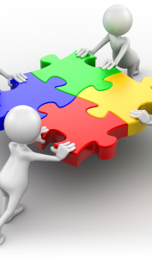
Consolidate and expand partnerships for health
Development of partnerships (between government and broader society)
Allows sharing of resources, expertise and skills.
Partnerships must be based on mutual respect and understanding.
This Photo by Unknown Author is licensed under CC BY-SA-NC

Slide 49

Increase community capacity and empower the individual
Health promotion is better carried out BY AND WITH people, not ON OR TO people.
Work to improve individual’s ability to take action
Work to improve capacity of groups/organisations to influence the determinants of health.
Individuals need to learn the skills and knowledge to effect change in their community
This Photo by Unknown Author is licensed under CC BY-NC-ND

Slide 50

Secure an infrastructure for health promotion
Funding on a local/national/global level must be found.
Resources must be in place (or planned) to maximize health promotion
All countries should develop the appropriate political/legal/educational/social/economic environments to support health promotion.
This Photo by Unknown Author is licensed under CC BY-SA

Slide 51
Activities
1. Think back to Erin Brockovich. Identify the sections of the Jakarta Declaration that were not well implemented.
2. Explain the impact participation has on empowerment.
3. Consider a health intervention that has taken place either at Kennedy or another school you are aware of. Which levels of participation were used in this intervention and WHY?

Slide 52
Source:
Lockhart, E. (2010). Health Studies Stage 2A-b. Madeley: Print Publishing.

Slide 53
Exam question practice
Develop your own question about the content we just covered. REMEMBER what the SYLLABUS is and what can be asked
Develop a marking key for this question
Swap with someone else and complete their question
(20 mins to answer)

Slide 54
Social Marketing
Definition & Purpose

Slide 55
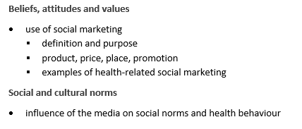
Syllabus link

Slide 56
Let’s recap…
Belief: a persons sense of right and wrong.
Attitude: the feelings an individual has towards objects, people or situations.
Values: general principles by which a person lives their life.

Slide 57
Let’s Recap…
Perception: The ability of a person to sense something-to analyse what is going on around them and make sense of it in their own mind. (is a result of their attitudes and beliefs)
Media: methods of communication that reach or influence people widely. (ie. Radio/Tv/Magazines/newspapers)
Marketing: the process of promoting/selling/distributing a product or service. (includes advertising, branding, packaging, storage, distribution and point of sale)

Slide 58
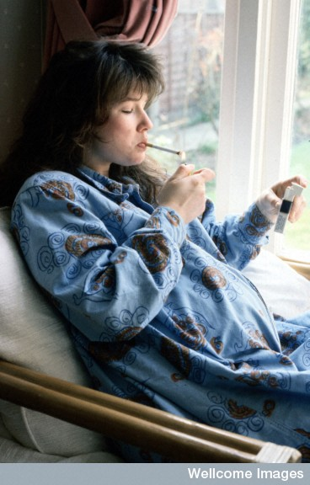
Example:
Pregnant lady smoking:
What is your attitude toward this?
What beliefs is this based upon?
What values is this based upon?
This Photo by Unknown Author is licensed under CC BY-NC

Slide 59

Social Marketing
“ a process for influencing human behaviour on a large scale, using marketing principles for the purpose of societal benefit rather than commercial profit ”
(W. Smith, Academy for Educational Development)
The Bottom Line:
-applying commercial marketing principles to health and human service programs looking to change behaviour for the benefit of society and not for commercial profit.
** it’s all about CHANGING BEHAVIOUR**

Slide 60
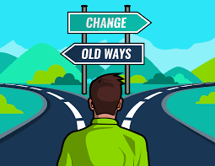
Social Marketing (continued)
Behaviour changes…
Accept a new behaviour
Reject a potential behaviour
Modify a current behaviour
Abandon an old behaviour
Why might these changes be difficult??
1. change is VOLUNTARY.
2. No promise of direct benefit or immediate payback from the behaviour change.

Slide 61
The Four P’s of Social Marketing
PRODUCT – Adam Sandler
PRICE - Ikea
PLACE - M
PROMOTION – Bolt
**These all relate to all social marketing campaigns.
**These must be tailored to the intended audience for a campaign to be effective

Slide 62
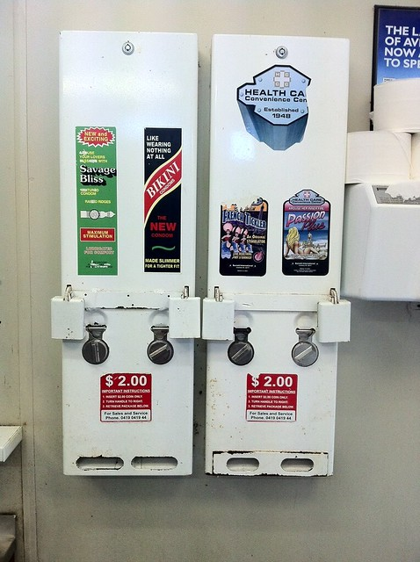
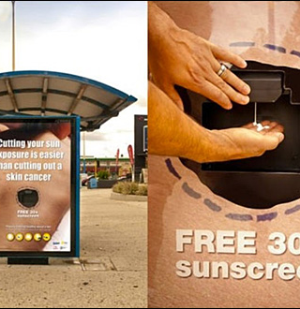
PRODUCT
Physical Objects, Knowledge, Attitudes or Behaviour that you want the intended audience to adopt
E.g. Sunscreen / Condoms
This Photo by Unknown Author is licensed under CC BY-NC
This Photo by Unknown Author is licensed under CC BY-SA

Slide 63
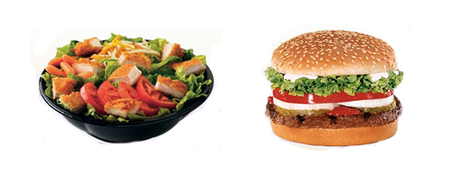
PRICE
What the intended audience must give up to receive the programs benefits.
E.g. $ vs $$$$

Slide 64
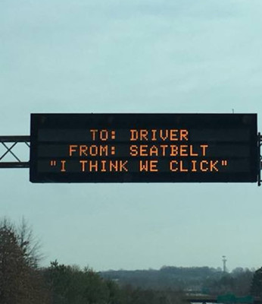
PLACE
Channel or HOW the message is disseminated/distributed

Slide 65
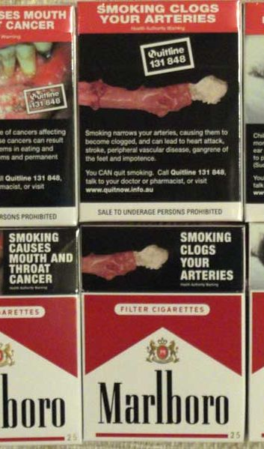
PROMOTION
Strategies used to convince the audience that the product is worth the price.
This Photo by Unknown Author is licensed under CC BY-SA-NC

Slide 66

Lets apply these to a a normal food advertisement first…

Slide 67
Now lets look at how a social marketing campaign works in comparison…

Slide 68
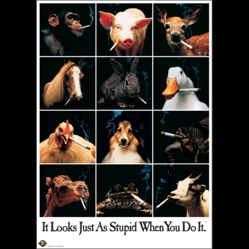
Apply the four P’s to this campaign…

Slide 69
PRODUCT:
Not smoking: either prevent someone from starting smoking, or convincing someone to quit smoking.
PRICE:
Standing up against peer pressure, dealing with addiction and withdrawal if you quit, The price of nicotine patches
PLACE:
Schools, local hangouts for young people, youth centre, doctors offices, bus stops
PROMOTION:
Comedic aspect. If you smoke you look as “stupid” as these animals

Slide 70
Animals Smoking Advertisement:
Who is the target audience?
(age, gender, socioeconomic status, education level etc)
Does it seem to be effective? WHY?

Slide 71
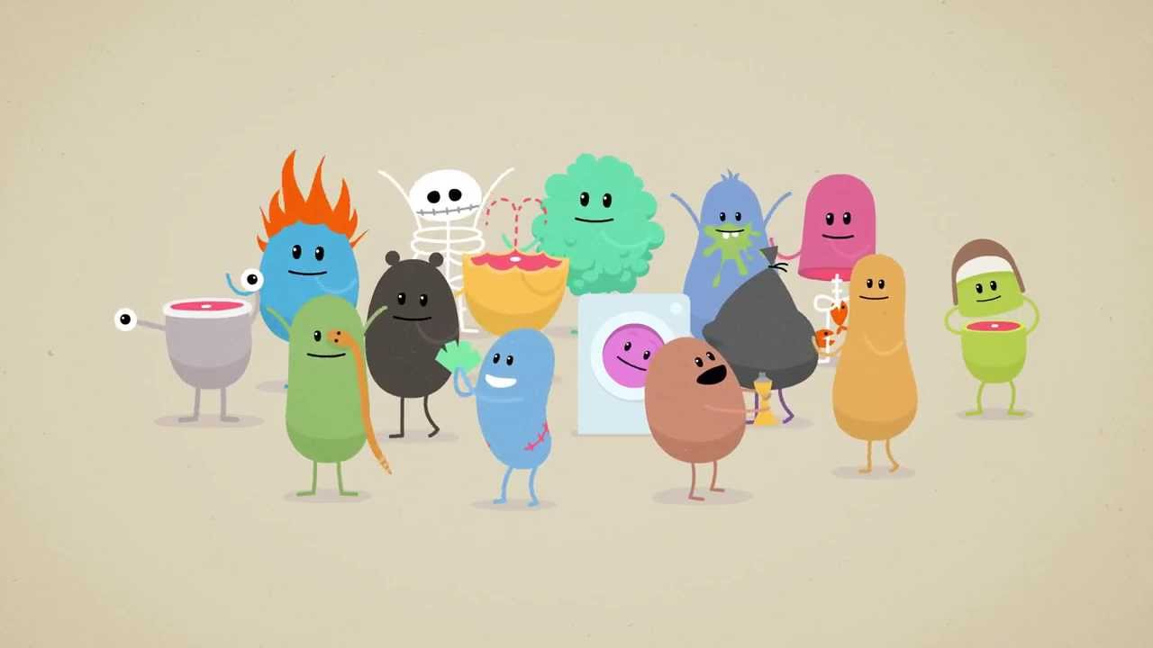
Characteristics of Effective Messages
1. Clear
2. Consistent
3. Credible
4. Attention grabbing
5. Persuasive
6. Suggest a next step of action
7. Personally relevant
8. Appropriately appealing
9. Culturally relevant
10. Conveyed through appropriate channels
11. Developed in a variety of formats
12. Pre-tested
https://www.youtube.com/watch?v=IJNR2EpS0jw

Slide 72
Top 10 commercials of 2016 YOUTUBE
https://www.youtube.com/watch?v=WMZChujwrBs

Slide 73
Some Ineffective Campaigns…
Colgate introduced a toothpaste in France called CUE. They later discovered that was the name of a notorious pornographic magazine.
Pepsi’s “Come alive with the Pepsi Generation” translated into “Pepsi brings your ancestors back from the grave” in Chinese.
Clairol introduced the “Mist Stick” hair curling iron, only to find out that in Germany the word “Mist” is slang for manure.
None of these were well received.

Slide 74

FOUR P’s
Product?
Price?
Place?
Promotion?

Slide 75

R U OK? Day
A great example of a SUCCESSFUL social marketing campaign.
PRODUCT: aims to change the perception of the consumer about mental health, and encourage them to help others who are not “OK”
PRICE: May require consumer to give up time or effort, maybe risk embarrassment or swallow their pride.
PLACE: Mostly in institutions like schools, universities and workplaces. Also, Social Media sites, other websites and mass media on the Day.
PROMOTION: Advertising, youtube, social media, merchandise, Hugh Jackman and Naomi Watts.

Slide 76

ACT, BELONG, COMMIT
PRODUCT?
PRICE?
PLACE?
PROMOTION?

Slide 77
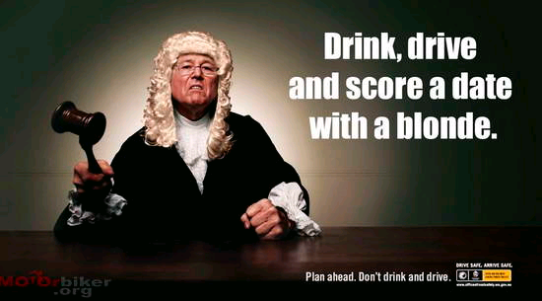
Product? Price? Place? Promotion?

Slide 78
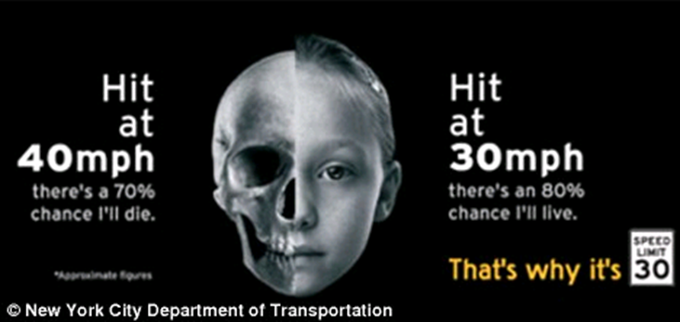
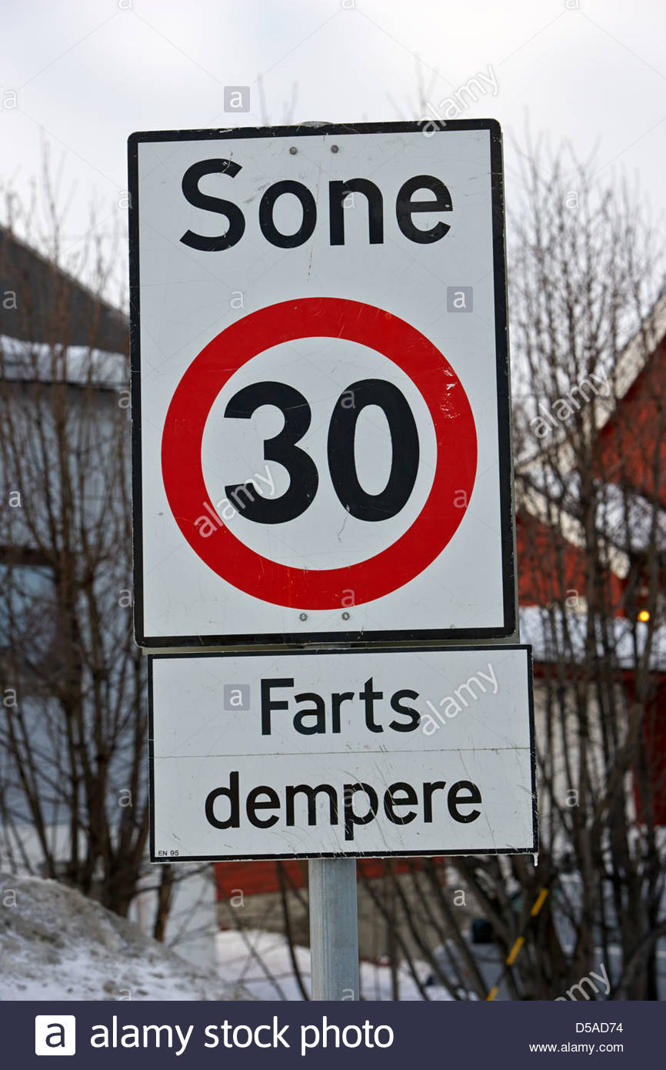

Compare and Contrast the Four P’s of these two adverts

Slide 79
The Use of Health Products and Services

Slide 80
Health Products and Services
There are many factors that influence which health products and services we choose to use.
List some of these factors:
.
.
.
.
.

Slide 81
Health Products and Services
1. Media
2. Transport
3. Cost
4. Consumer Confidence

Slide 82
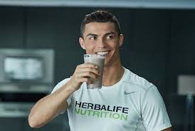
MEDIA
Consumers can be swayed to choose one brand over another due to advertising or use by a favourite celebrity
Media producers try to persuade customers to use their product.
CREATE AN EXAMPLE OF WHEN YOU HAVE SEEN THIS
YOUTUBE: “Stay Beautiful: Ugly truth in beauty magazines” 4mins https://www.youtube.com/watch?v=zIIKTNPP5Ts

Slide 83
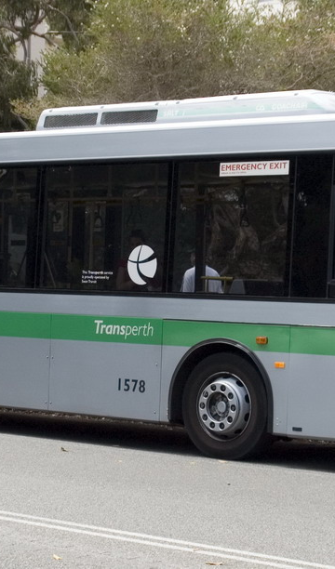
TRANSPORT
Availability of public transport, parking and accessibility can all influence the use of health products and services. https://www.blackmores.com.au/ - Easy online shopping
Customers are more likely to use products and services that are easy to access, have free and safe parking and are close to a train or bus stop.
Emergency services (ie. Ambulance)
https://www.fsh.health.wa.gov.au/~/media/Files/Hospitals/FSH/PDFs/Make-your-move.pdf Easy access via public transport
This Photo by Unknown Author is licensed under CC BY-SA

Slide 84

COST
The financial expense of a product may influence selection. https://www.ipn.com.au/gp/wa-claremont-claremont-medical-centre/our-services/
Are more expensive products/services better “Quality” and more “safe”???
Health insurance https://www.canstar.com.au/health-insurance/what-does-health-insurance-cost/
Low income earners often have less choice
https://science.howstuffworks.com/innovation/everyday-innovations/sunglass1.htm
This Photo by Unknown Author is licensed under CC BY-ND

Slide 85
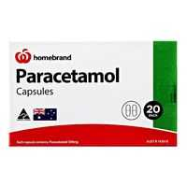

CONSUMER CONFIDENCE (Products)
Consumers have increased confidence in brands that are true to their promises.
Trusted brands develop an emotional connection between the product and the customer…ie PANADOL and BAND AIDS.
https://www.youtube.com/watch?v=6ZhMfzc9RbU Ladder infomercial

Slide 86
CONSUMER CONFIDENCE (Services)
Watching a medical procedure on a tv show will increase an individuals confidence to undergo a medical procedure…WHY?
https://www.youtube.com/watch?v=CsNpfMldtyk – Surgical checklist
Demystify the procedure
Makes the consumer feel more educated

Slide 87
PRODUCT PLACEMENT
What is it?
“The use of specific products in a movie or television program where the manufacturer pays the media producer as a form of advertising” https://www.youtube.com/watch?v=PSaasBjeJek
Eg. “the Truman Show-product placement” youtube
https://www.youtube.com/watch?v=Inscky6EyQ8
https://www.youtube.com/watch?v=4cgVR7YZuVU

Slide 88
Revision Questions
SHORT RESPONSE
(Page 63 textbook)
Q.13 and Q.14

Slide 89
Syllabus link

Slide 90
Sources
Lockhart, E. (2010). Health Studies Stage 2A-b. Madeley: Print Publishing.
Act, Belong, Commit.
http://www.actbelongcommit.org.au/
RU OK? Day
http://yourstruly.org.au/#/story
Graph taken from Australian Bureau of Statistics (2006)
http://www.abs.gov.au/AUSSTATS/abs@.nsf/Latestproducts/4233.0Main%20Features22006
Image taken from https://everypixelcounts.wordpress.com/2011/04/15/enjoy-the-ride-rebranding-slow/
Image take from google search Ronaldo - herbalife

Slide 92
Epidemiology

Slide 93
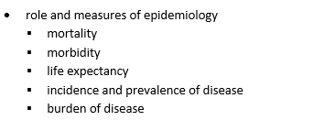
Syllabus link

Slide 94
What is Epidemiology?
Such a fancy word so what does it mean? - https://www.youtube.com/watch?v=r9poHB-ldqk Explanation (7 mins)
Epidemiology is
“ the study of the distribution and determinants of health related conditions in specified populations, and the application of this study to control health problems.”
In less fancy words: the study of data and statistics.

Slide 95
What is Epidemiology?
Epidemiology includes these health measures:
Morbidity
Mortality
Infant mortality
Incidence of disease
Prevalence of disease
Burden of disease
Life expectancy
WHAT DO THESE MEAN?

Slide 96
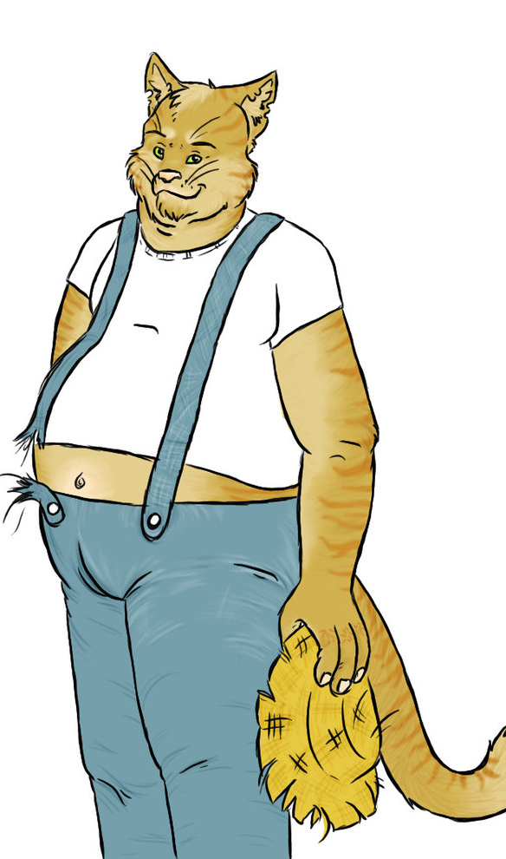
Morbidity
Sickness or Illness.
Morbidity Rate: refers to the number of people who are sick or diseased in a population.
The number of Unhealthy People.
How to remember?
- Morbidly obese means most likely living with a disease
This Photo by Unknown Author is licensed under CC BY-NC-ND

Slide 97

Mortality
Death.
Mortality Rate: the number of people who have died in a population.
OR can describe the number of people who have died due to a particular cause…
Eg. Mortality due to influenza
Way to remember
Mortal kombat is a fighting game. One player dies
This Photo by Unknown Author is licensed under CC BY-SA-NC

Slide 98

Infant Mortality
The death of babies or children.
Can be measured UNDER 1 Year of age (babies who don’t live to see their first birthday)
OR can be measured UNDER 5 Years of age
It is the number of babies who die, or the proportion of live births who don’t survive 1/5 years within a population.
Does NOT include stillbirths.
This Photo by Unknown Author is licensed under CC BY

Slide 99

Incidence of Disease
The number of NEW cases of a disease or condition in a specific place and time period.
It indicates the RISK of contraction of a disease/illness of an individual
Used to track disease outbreak and spread.

Slide 100
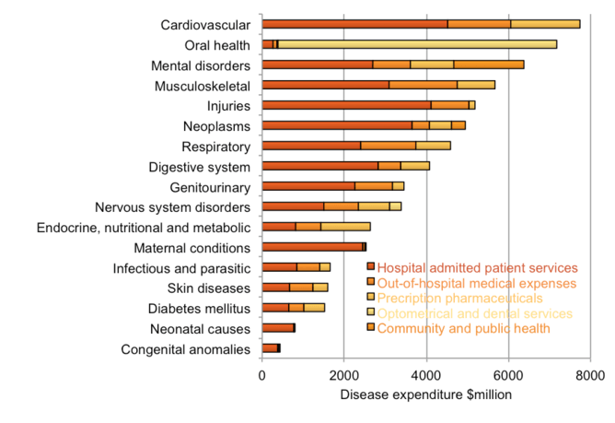
Prevalence of Disease
The overall number of cases of a specific disease in a given population at a certain time.
Provides an indication of the overall size of the health problem (how many people are affected/how widespread it is)
This Photo by Unknown Author is licensed under CC BY-ND

Slide 101
Comparing Incidence and Prevalence of disease:
1960 --------------------------------------------------2010

Slide 102
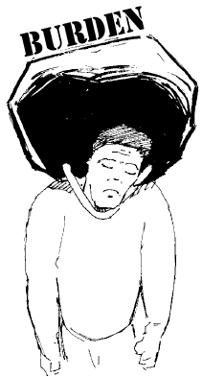
Burden of Disease
The health loss of society due to disease or injury that REMAINS after treatment/rehabilitation/prevention efforts.
One measure is DALY’s (Disability-Adjusted Life Years)
DALY=YLL+YLD
YLL: Years of Life Lost due to morbidity
YLD:Years of Life lost due to Disability
This Photo by Unknown Author is licensed under CC BY-NC-ND

Slide 103
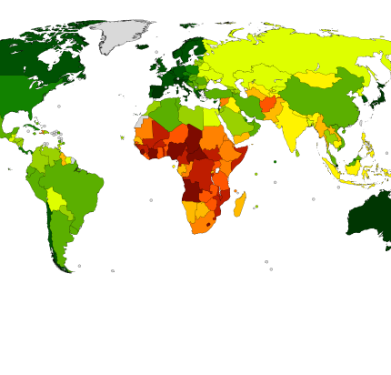
Life Expectancy
“How long, on average, a person is expected to live, specific to population or origin or ethnic group”
Based on a statistical average of recent mortality rates.
This Photo by Unknown Author is licensed under CC BY-SA

Slide 104

Why is Epidemiology Used?
Monitor the burden of disease in specific populations
Predicting life expectancies
Monitor disease outbreaks
Advise and inform health promotion
Determine whether a problem exists
Predict whether the problem is likely to exist in the future.
https://www.youtube.com/watch?v=Jd3gFT0-C4s What is epidemiology 10 mins
This Photo by Unknown Author is licensed under CC BY-SA-NC

Slide 105

Questions that Epidemiologists ask…
Which individuals have experienced the event?
When did they experience the event?
Where are the individuals who have experienced the event?
What environmental factors are associated with the event?

Slide 106
Epidemiology Triangle – Click here
HOST
Age, sex, immune status, previous disease
AGENT
Bacteria, virus, chemical, radiation
ENVIRONMENT
Temperature, crowding, pollution, water
The E-Triangle is used when epidemiologists are trying to understand how an infectious disease spreads.

Slide 107
Questions for Understanding
Explain the difference between Mortality and Morbidity. 3 marks – SHARE RESPONSES
What is the difference between Incidence of disease and prevalence of disease? 2 marks – SHARE RESPONSES
What is the prevalence of cardiovascular disease in Australia?
Is the Life expectancy of Australians getting better or worse? Explain using Epidemiology Measures.
How does Australians Life expectancy compare with India, USA and Finland?

Slide 108

Activity
Go to http://www.health.gov.au/casedefinitions
Select an infectious disease from the right hand side
Research this disease and answer the following questions:

Slide 109
Case questions
What is the causative agent? (ie. Bacteria/virus etc)
What is the point of entry into the body?
What is the mode of transmission of this disease?
What symptoms does the patient have?
What is the treatment?
What is the prevalence of this disease in Australia at the moment?
How can this disease be prevented?
Is there a specific population that is at higher risk?

Slide 110
Syllabus link

Slide 111
Preventive Strategies

Slide 112
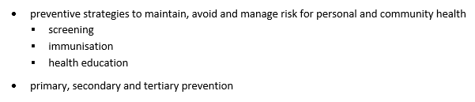
Syllabus link

Slide 113
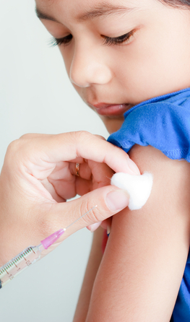
4 Main Preventive Strategies
Screening
Immunisation
Health Education
Primary, Secondary and Tertiary Prevention
This Photo by Unknown Author is licensed under CC BY-ND

Slide 114
Screening
Testing and monitoring a non-symptomatic population for signs of disease (before they even know they are sick).

Slide 115

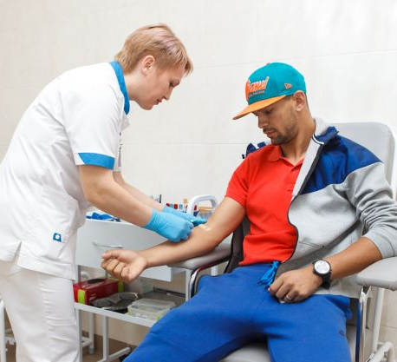

Conditions that must be met for screening to be effective:
1) Individuals must have the capacity to recognise early warning signs and know they should seek treatment OR there needs to be a test that detects signs at a very early stage.
2) There must be a test to confirm the suspected disease.
3) There must be a reliable treatment that is successful in stopping the disease and its progression.
This Photo by Unknown Author is licensed under CC BY-SA-NC
This Photo by Unknown Author is licensed under CC BY-NC-ND

Slide 116
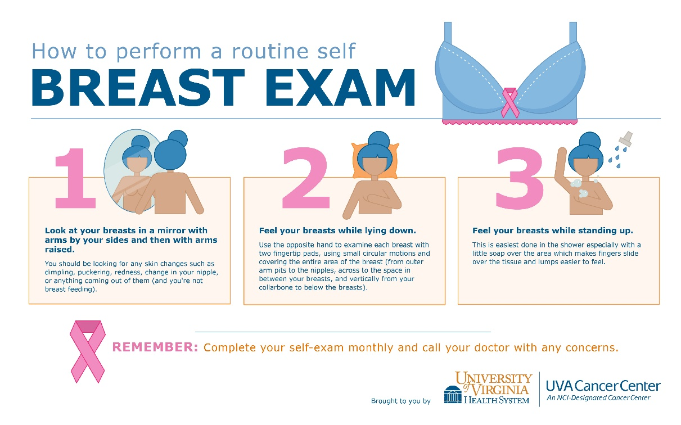
Screening
There is a range of diseases that can be detected at an early stage, can you think of any?
Skin cancer, breast cancer, prostate cancer, colon cancer (Lockhart, 2015), cervical cancer, newborn screening, infant hearing screening (State Government of Victoria, 2014).
Reading pg 43 (case study + table 3.1)
https://www.cancer.org/cancer/testicular-cancer/detection-diagnosis-staging/detection.html

Slide 117
Cancer screening in Australia
CANCER | SCREENING | POPULATION
Breast cancer | Self examination Mammogram | All women (once breasts have developed) Every 2 years (50-69yrs)
Colon Cancer | Faecal occult blood test | People turning 50, 55, 60, 65 yrs old. Test sent in the mail.
Skin Cancer | Self examination | Everyone
Cervical Cancer | Pap smear | Every 2 years once sexually active and 6 weeks post birth/pregnancy
Testicular cancer | Self check | All males from puberty

Slide 118
Immunisation-Definitions
https://www.youtube.com/watch?v=rb7TVW77ZCs How they work
Bacteria-”Single-celled microorganisms that can exist as either independent organisms or as parasites.”
Immunisation-The term used for the process of getting the vaccine, and becoming immune as a result.
Immunity-The ability of an organism to resist a particular infection or toxin by the action of specific antibodies or sensitized white blood cells.
Natural Immunity-May be possessed by a group that is present in an individual at birth prior to exposure to an antigen. (example: placental transfer of IgG)

Slide 119
Immunisation-Definitions
Vaccinate-”The act or practice of vaccinating, inoculation with vaccine.”
Vaccine-Any preparation intended to stimulate the production of antibodies to prevent disease.
Virus-A microorganism that is smaller than bacteria and cannot grow or reproduce separate from a living cell. It will invade a living cell and use its chemical makeup to keep alive and to replicate itself.
Reading pg 44/45

Slide 120
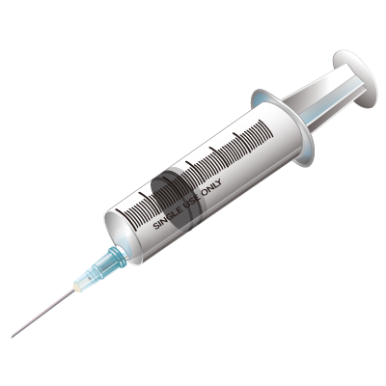
Immunisation
The human body uses white blood cells (wbc’s) to defend itself from harmful intruders (antigens).
The white blood cells make antibodies that are specific to each antigen, which will destroy them.
A vaccine is a dead or weakened copy of an antigen.
Because the antigen is weakened or dead, it does not make the person sick, instead allowing the body to create antibodies that will combat the antigen in the future.
This is successful because memory cells in the body will always stay on the lookout for this disease and will be able to quickly produce antibodies if the antigen does enter the body.
This Photo by Unknown Author is licensed under CC BY-SA

Slide 121

Health Education
Definition: “Any combination of learning experiences designed to help individuals and communities improve their health, by increasing their knowledge or influencing their attitudes.”
Can be used to promote health through the development of skills.
One of the key aims of health education is to improve health literacy. It empowers students to critically evaluate situations that they may face in society, and to safe decisions.
9 min video on bias and immunization – Interesting https://www.youtube.com/watch?v=Rzxr9FeZf1g
This Photo by Unknown Author is licensed under CC BY-NC

Slide 122
Health Education
Some well know educational and behavioural campaigns from the past:
“Life. Be in it.” From the 1970’s
“Slip Slop Slap” beginning in 1981.
Grim Reaper Campaign from 1987.
National Heart Foundation’s tick endorsement program.
“Every cigarette is doing you damage”. 1997
“Go for 2&5”. 2005
Many of these were (and still are) incorporated into school-based health education classes.

Slide 123
Health Promoters
https://www.youtube.com/watch?v=BGNHBllcZuQ
Outline of 5 levels
As health promoters, what is the long term motto that we live by?
“Prevention is better than Cure”
What examples of preventive strategies have you seen/heard of in your life?

Slide 124
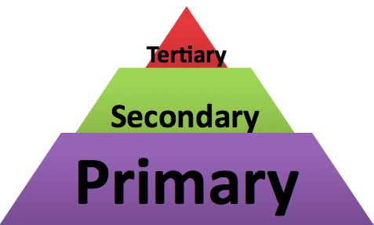
Levels of Prevention
There are 3 levels of disease prevention that can be used to avoid, minimise and manage injury and disease:
Primary Prevention
Secondary Prevention
Tertiary Prevention
Explanation- 1:54 https://www.youtube.com/watch?v=TlGe80Mi85U

Slide 125

Primary Prevention
Aimed at the population as a whole and sets out to prevent the disease before it occurs.
The most cost-effective level. Why?
It avoids diagnosis, detection, treatment and recovery-”prevention is better than cure”, this is the best (and earliest) possible case of prevention.
E.g. Immunisation, health education, pasteurisation, clean water, healthy eating.

Slide 126
Primary Prevention
Aims to completely avoid all suffering, cost and burden of disease by intervening before any illness can occur.
Referred to as “upstream” prevention, as it leaps ahead and prevents the problem before it has actually occurred.

Slide 127

Secondary Prevention
Also referred to as early detection.
Locates symptoms at a very early stage. By finding the disease/illness at an early stage, it will generally be easier to treat.
The most obvious example of secondary prevention is screening.
Referred to as “midstream” prevention because it detects the problem as it is occurring, often before the patient has noticed it and before it gets too serious.

Slide 128

Tertiary Prevention
The final stage of prevention. When the other levels of prevention have not been able to stop the disease, tertiary prevention will step in to try and “fight” the disease.
Includes treatment, surgery, medication and recovery techniques.
Attempts will be made to minimise the negative impacts of the disease, restore function and prevent complications.
Referred to as “downstream” prevention as it occurs after the condition has taken hold of the body.

Slide 129
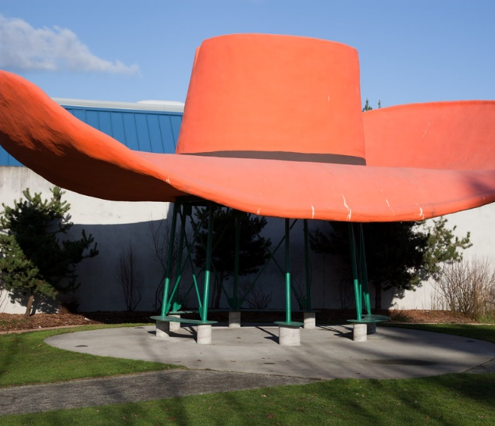
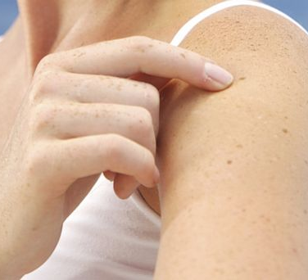

Lets look at an example:
Skin Cancer…
PRIMARY: wearing sunscreen, hats, staying in shade
SECONDARY: self examination and formal skin checks
TERTIARY: getting a melanoma removed via surgery
This Photo by Unknown Author is licensed under CC BY-SA-NC

Slide 130
Activity
1) Class debate. Topic “should childhood immunisation be compulsory”.
2) Explain how a vaccine improves the immunity of an individual.
3) What three factors must be in place for screening to work? Why?
4) Use a disease/condition from epdimiology topic and create a case study person. From birth to death create a response that shows how they might fit in with
- Immunisation
- Screening
- Health Education
- Pri, Sec, Ter prevention
4) Create a table that includes the 3 levels of Prevention, with a definition for each and an EXAMPLE. (other than skin cancer)

Slide 131
Syllabus link

Slide 132
Sources
Lockhart, E. (2010). Health Studies Stage 2A-b. Madeley: Print Publishing.

Slide 133
National Strategic Framework for Chronic Conditions

Slide 134
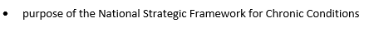
Syllabus link

Slide 135
Lets Brainstorm:
What do you consider to be the biggest health issues in Australia?

Slide 136
Purpose of the National Strategic Framework for Chronic Conditions
Syllabus content
HOLISTIC HEALTH
Purpose of the National Strategic Framework for Chronic Conditions
https://www.youtube.com/watch?v=WZKAKQ5RwbM Explanation 5 mins

Slide 137
National Strategic Framework for Chronic Conditions (NFCC)
The National Strategic Framework for Chronic Conditions is the overarching policy document for chronic conditions that sets the direction for the Australian Department of Health to achieve its Vision that “all Australians live healthier lives through effective prevention and management of chronic conditions.” It is a federal government initiative
http://www.health.gov.au/internet/main/publishing.nsf/content/nsfcc

Slide 138
What are chronic conditions?
Chronic • Persisting for a long time or constantly recurring. • A disease that lasts 3 months or more • Long lasting conditions with persistent effects.
Chronic conditions • Chronic conditions are the leading cause of illness, disability and death in Australia (Australian Department of Health, 2017)
• ‘Chronic conditions’ refers to a broad range of chronic and complex health conditions across the spectrum of illness, including mental illness, trauma, disability and genetic disorders. (Australian Department of Health, 2017)

Slide 139
What are chronic conditions? cont
Chronic conditions have complex and multiple causes; are generally long-term and persistent, and often lead to a gradual deterioration of health and loss of independence. While not usually immediately life threatening, chronic conditions are the most common and leading cause of premature mortality. (Australian Department of Health, 2017)
Many chronic conditions occur across the life cycle, although they become more prevalent with older age and can compromise quality of life and create limitations and disability. (Australian Department of Health, 2017)

Slide 140
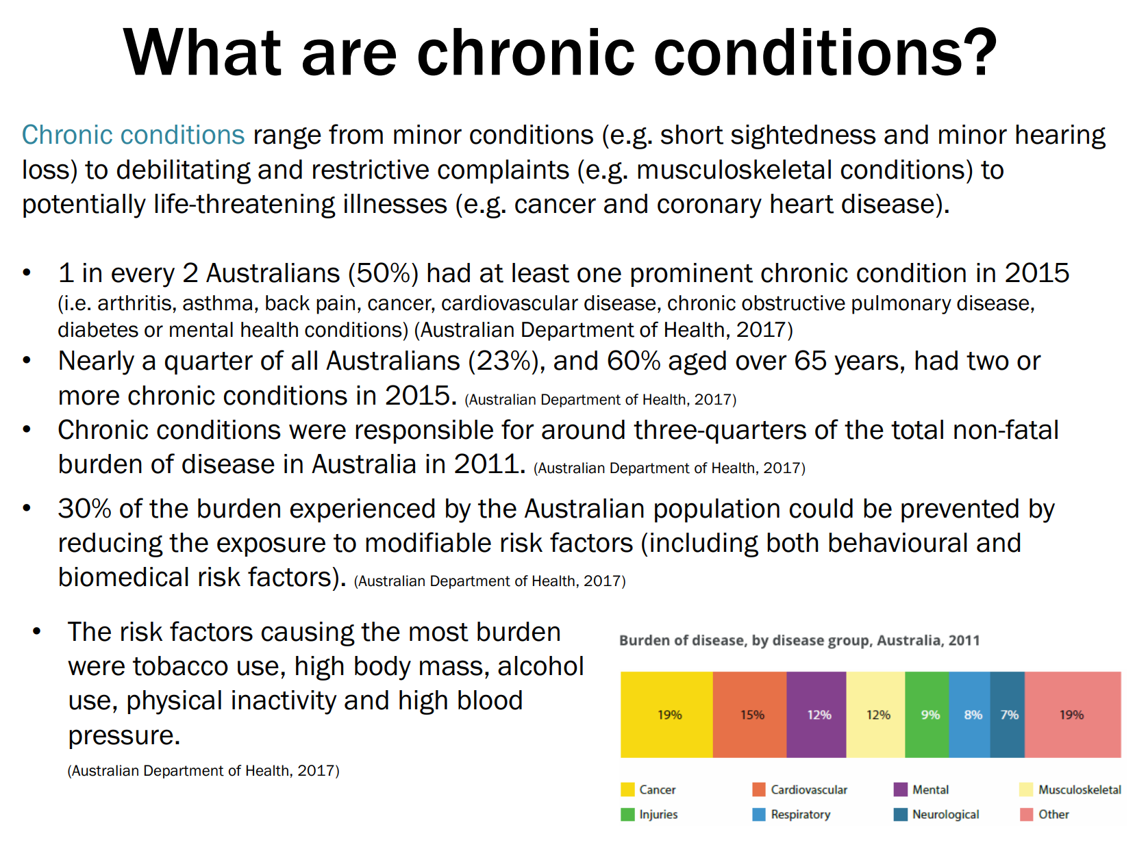

Slide 141
How common are they and who is at risk? (not examinable)
Chronic conditions range from minor conditions (e.g. short sightedness and minor hearing loss) to debilitating and restrictive complaints (e.g. musculoskeletal conditions) to potentially life-threatening illnesses (e.g. cancer and coronary heart disease).
According to self-reporting in the 2014-15 National Health Survey, 1 in every 2 Australians (50%) have at least one prominent (i.e. arthritis, asthma, back pain, cancer, cardiovascular disease, chronic obstructive pulmonary disease, diabetes or mental health conditions) chronic condition¹.
2014-15 National Health Survey data also indicated that nearly a quarter of all Australians (23%), and 3 in every 5 Australians (60%) aged over 65 years, had two or more chronic conditions¹.
Chronic conditions were responsible for around three-quarters of the total non-fatal burden of disease in Australia in 2011².

Slide 142
How common are they and who is at risk? (not examinable)
About a third of the burden experienced by the population could be prevented by reducing the exposure to modifiable risk factors (including both behavioural and biomedical risk factors). The risk factors causing the most burden were tobacco use, high body mass, alcohol use, physical inactivity and high blood pressure (Australian Institute of Health and Welfare 2016).
Aboriginal and Torres Strait Islander people experience poorer health and have worse health outcomes than other Australians, with a burden of disease 2-3 times greater than the general Australian population. In addition, they are more likely to:
die at a younger age (death rates are around 5 times that for non-Indigenous people in the 35-44yrs age group);
experience disability; and
report their health as fair ³.
Increasing prevalence of chronic conditions has also been attributed to early detection and improved treatments for diseases that previously caused premature death, as well as behavioural factors, such as smoking or poor diet, that increase the risk of developing chronic conditions.
Population ageing and improved treatments have also contributed to people living longer with chronic conditions.

Slide 143
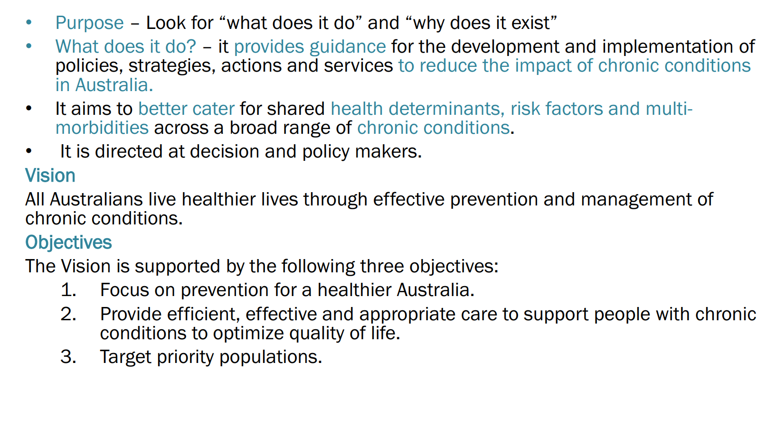
NFCC – What you need to know

Slide 144
Research task #1 30 mins
Investigate, using the NSFCC website, what:
The purpose of the NSFCC is
What does it do (policies, strategies, actions, services) and how does it reduce impact for those with Chronic Cond
What are the NSFCC aims?
Create a case study (someone with co-morbidities) and show how NSFCC can improve their life. Must be in detail (e.g. 2-3 paragraphs min)

Slide 145
Research task #2 30 mins
Investigate 3 Chronic conditions by examining the NSFCC Website
Short summary of condition
Risk factors
What prevention could be used (specifics)
How the NSFCC addresses the condition
Identify the vison and objectives of the NSFCC
Explain what each mean in relation to individual/community health

Slide 146
WHY are these issues in Australia?
Plentiful lifestyle
Easy access to unhealthy food/tobacco
Transport
Lazy, relaxed lifestyle.
These all contribute to many Australians being overweight and developing many preventable conditions.

Slide 147
Revision Question
Describe in detail what the purpose of the NSFCC is.
What does the NSFCC do?
Who is the NSFCC for and how would it help them? Describe in detail with examples to support your answer
Chose one other topic we have covered this term and show how there is a strong link between NSFCC and that topic

Slide 148
Sources
Australian Institute of Health and Welfare 2016. Australia's health 2016. Australia's health no. 15. Cat. no. AUS 199. Canberra: AIHW.
Australian Institute of Health and Welfare 2016. Australian Burden of Disease Study: impact and causes of illness and death in Australia 2011. Australian Burden of Disease Study series no. 3. Cat. no. BOD 4. Canberra: AIHW.
Australian Institute of Health and Welfare 2014. Australia's health 2014. Australia's health series no. 14. Cat. no. AUS 178. Canberra: AIHW.
Australian Bureau of Statistics 2016. 3303.0 - Causes of Death, Australia, 2015. Canberra: ABS. Accessed 17 March 2017.
World Health Organization. Health Topics: Risk factors [Internet]. Geneva, Switzerland: WHO; 2016 [cited 5 January 2016]. Available from: http://www.who.int/topics/risk_factors/en/
http://www.health.gov.au/internet/main/publishing.nsf/content/chronic-disease

